Slide 1
Lecture #25
SOFT COMPUTING
INT508
Genetic Algorithm

Slide 2
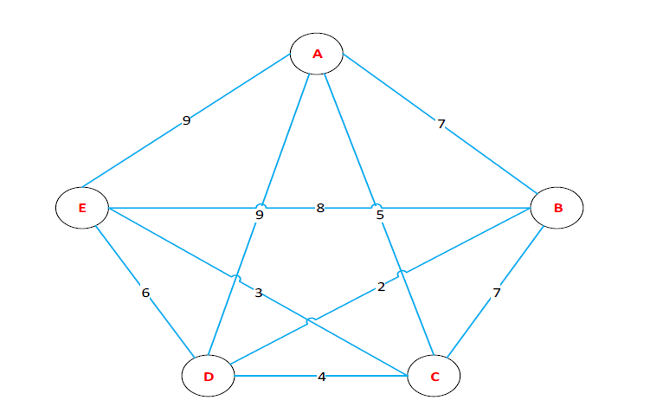
Example of GA
Traveling Salesman Problem Solution using Genetic Algorithm
There are five cities that a salesperson will pass. The cities are A, B, C, D, and E. The journey starts from A and ends at A as well.

Slide 3
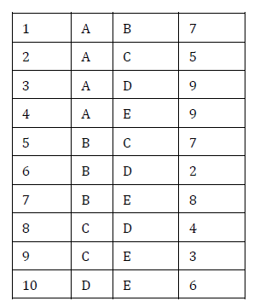
Example of GA
Traveling Salesman Problem Solution using Genetic Algorithm

Slide 4
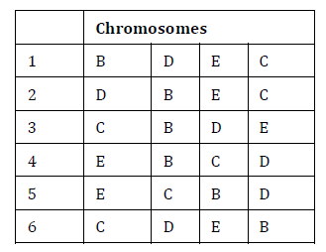
Example of GA
Traveling Salesman Problem Solution using Genetic Algorithm
Try to find the smallest global optimum value. Chromosome initialization is done.

Slide 5
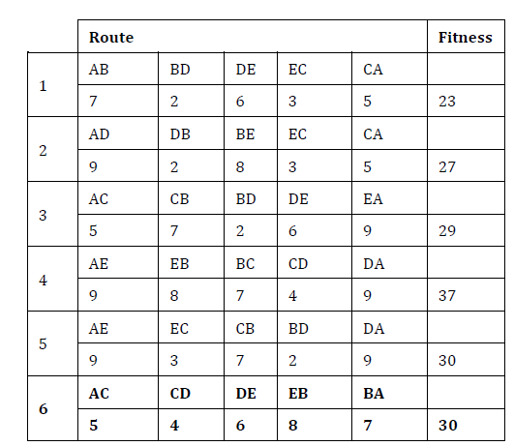
Example of GA
Traveling Salesman Problem Solution using Genetic Algorithm

Slide 6
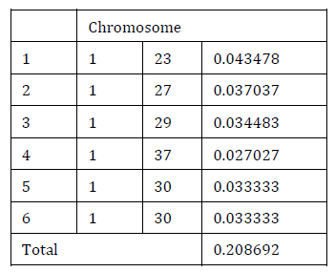
Example of GA
Traveling Salesman Problem Solution using Genetic Algorithm

Slide 7
Example of GA
Traveling Salesman Problem Solution using Genetic Algorithm
Crossover is done to produce children from two mothers who are mated.
The resulting chromosomes are expected to increase the value of fitness.
The number of chromosomes that experience crossover is determined by crossover probability.
The crossover probability value is 0.25.

Slide 8
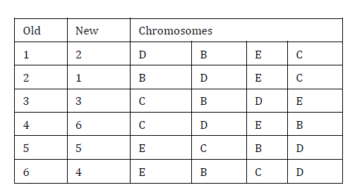
Example of GA
Traveling Salesman Problem Solution using Genetic Algorithm

Slide 9
Example of GA
Traveling Salesman Problem Solution using Genetic Algorithm
This section will be carried out of the mutation process.
This mutation works to exchange genes for genes on other chromosomes. Expected results increase the value of fitness to be achieved.
If a gene is exchanged at the end of a chromosome, this gene will be exchanged for the first gene.
There is a parameter to determine how many genes will be mutated. The mutation rate is 0.2.

Slide 10
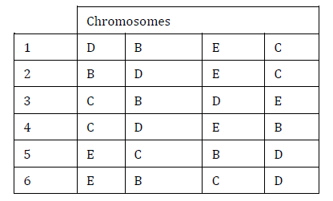
Example of GA
Traveling Salesman Problem Solution using Genetic Algorithm

Slide 11
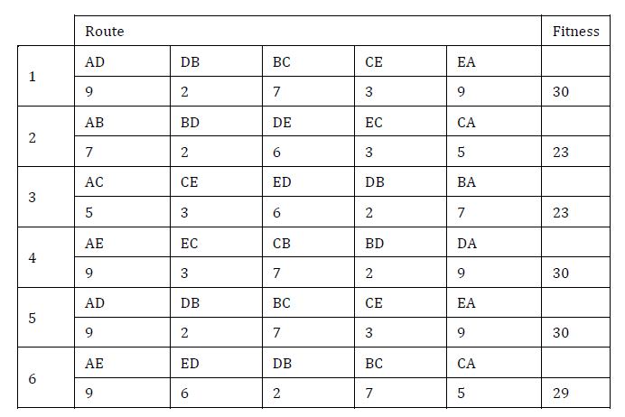
Example of GA
Traveling Salesman Problem Solution using Genetic Algorithm

Slide 12
Example of GA
Traveling Salesman Problem Solution using Genetic Algorithm
In the first generation, it has been seen that there is the smallest fitness value that does not change.
If the calculation is continued up to the Nth generation, then it is assumed that the lowest fitness value will remain unchanged.
Although the calculation is sufficiently elaborated up to the 1st generation, a near-optimal solution has been found, from the genetic algorithm process above, the final result the route with the shortest optimal distance is A, B, D, E, C, A.

Slide 13
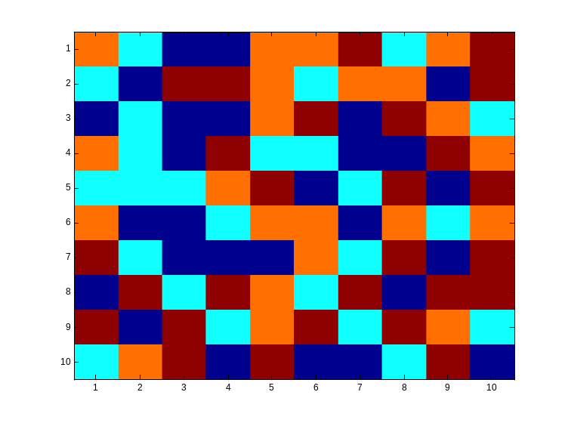
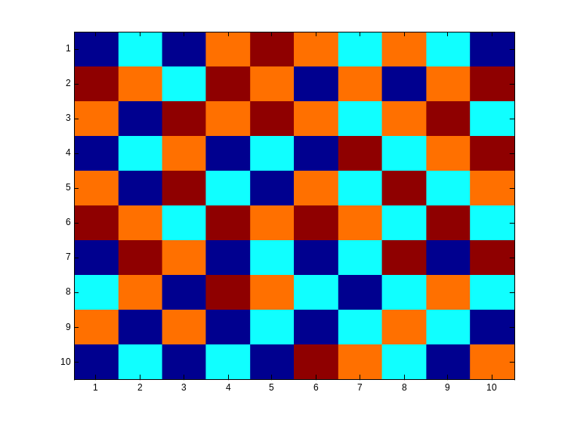
Checkboard example
  We are given an n by n checkboard in which every field can have a different colour from a set of four colors.
  Goal is to achieve a checkboard in a way that there are no neighbours with the same color (not diagonal)

Slide 14
Checkboard example Cont’d
  Chromosomes represent the way the checkboard is colored.
  Chromosomes are not represented by bitstrings but by bitmatrices
  The bits in the bitmatrix can have one of the four values 0, 1, 2 or 3, depending on the color.
  Crossing-over involves matrix manipulation instead of point wise operating.
  Crossing-over can be combining the parential matrices in a horizontal, vertical, triangular or square way.
  Mutation remains bitwise changing bits in either one of the other numbers.

Slide 15
Checkboard example Cont’d
  This problem can be seen as a graph with n nodes and (n-1) edges, so the fitness f(x) is defined as:
  f(x) = 2 · (n-1) ·n

Slide 16
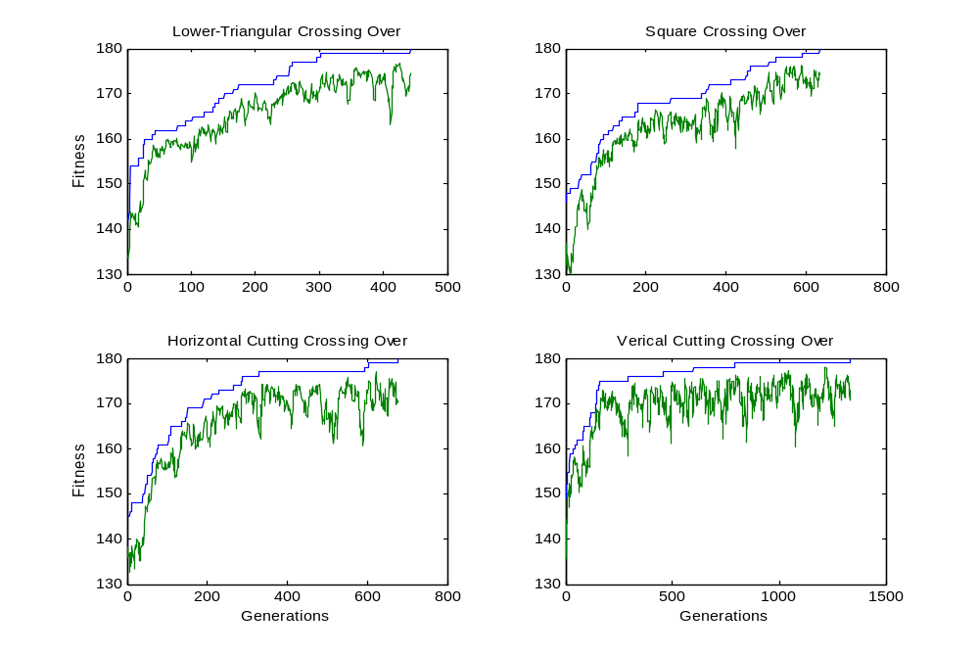
Checkboard example Cont’d
  Fitnesscurves for different cross-over rules:

Slide 17
Q & A
1. Matrix crossover is also known as _________
One dimensional
Two dimensional
Three dimensional
None of the above

Slide 18
Q & A
1. Matrix crossover is also known as _________
One dimensional
Two dimensional
Three dimensional
None of the above

Slide 19
Q & A
2. Idea of genetic algorithm came from
A: machines
B: Birds
C: ACO
D: genetics

Slide 20
Q & A
2. Idea of genetic algorithm came from
A: machines
B: Birds
C: ACO
D: genetics

Slide 21
Q & A
3. Chromosomes are actually ?
A: line representation
B: String representation
C: Circular representation
D: all of these

Slide 22
Q & A
3. Chromosomes are actually ?
A: line representation
B: String representation
C: Circular representation
D: all of these

Slide 23
Q & A
4. what are the parameters that affect GA are/is
A: selection process
B: initial population
C: both a and b
D: none of these

Slide 24
Q & A
4. what are the parameters that affect GA are/is
A: selection process
B: initial population
C: both a and b
D: none of these

Slide 25
Q & A
5. Survival is ___ approach.
A: deteministic
B: non deterministic
C: semi deterministic
D: none of these

Slide 26
Q & A
5. Survival is ___ approach.
A: deteministic
B: non deterministic
C: semi deterministic
D: none of these

Slide 27

12/12/14
CSE510, Lovely Professional University, Phagwara

